Slide 1
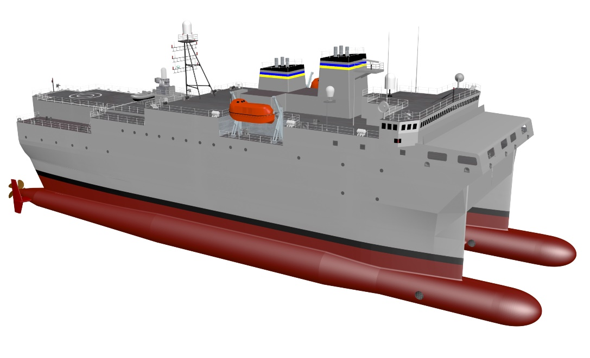
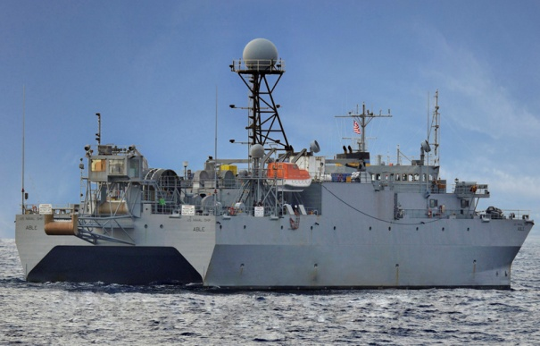
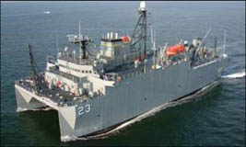
Auxiliary General Ocean Surveillance Ship
T-AGOS(X) Program
INDUSTRY DAY
26 June 2019
T-AGOS(X) Notional Concept
T-AGOS 19 Class
T-AGOS 23 Class

Slide 2
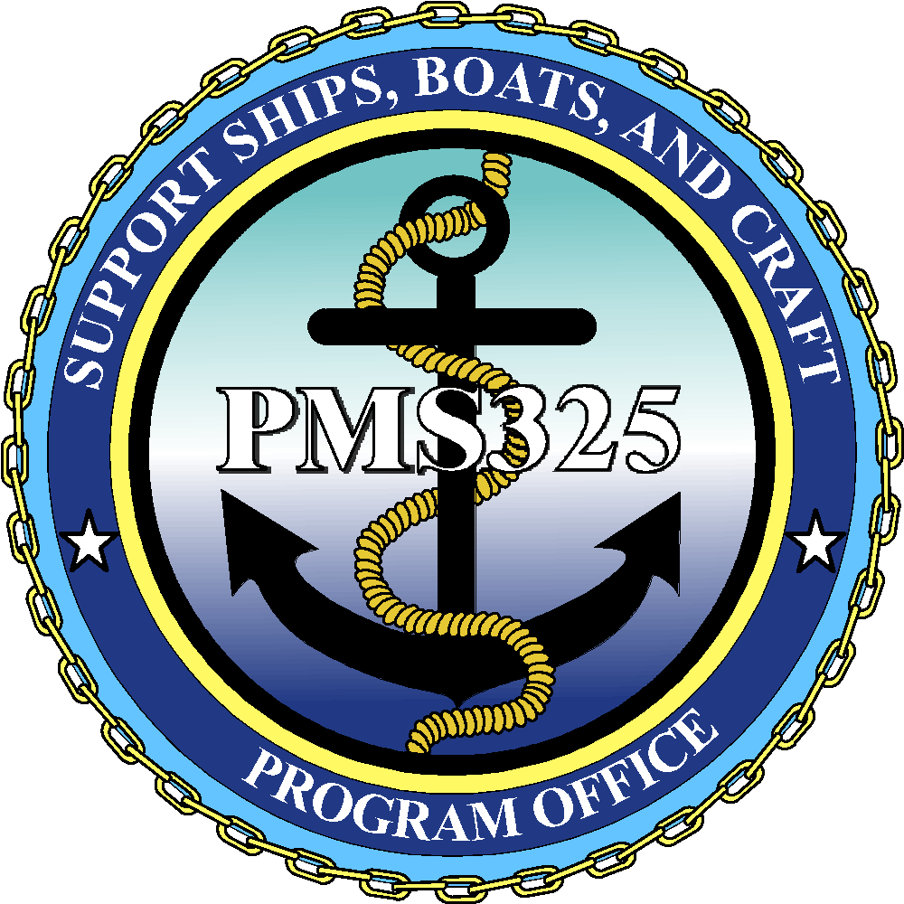
INDUSTRY DAY AGENDA
0815-0900 | Check in
0900 | Welcome and Introductions
 | Roles and Responsibilities of Government Team
 | Program History, Mission, and CONOPS
 | Acquisition Approach and Schedule Overview
 | Overview of Industry Studies Solicitation
 | Design Overview
 | Question and Answer Session
 | Closing Remarks
1100-1215 | Lunch Break
1215-1600 | Breakout Sessions With Government Team (as Scheduled)
‹#›
‹#›
Notes:
‹#›
T-AO Fleet Oiler Recapitalization

Slide 3
WELCOME AND INTRODUCTIONS
‹#›
Notes:
T-AO Fleet Oiler Recapitalization
‹#›

Slide 4
INTRODUCTIONS
PMS325 Support Ships, Boats, and Craft: Program Office
NAVSEA 02: Contracting
NAVSEA 05D: Ship Design Manager
Military Sealift Command (MSC): End user
OPNAV N97 (Underwater Warfare): Resource sponsor
PMS485: Mission System Program Manager
‹#›

Slide 5
RULES OF ENGAGEMENT
IAW FAR 15.201, the purpose of this Industry Day is to exchange information to improve the understanding of the Government requirements and industry capabilities
Nothing herein is to be construed as constituting any commitment whatsoever on the part of the Government
The Navy is not soliciting, nor will the Navy accept, any proposals at this time
No recording devices may be used
If you are interested in this program, please monitor the Federal Business Opportunities (FBO) website at http://www.fedbizopps.gov
Please direct any comments, concerns, or questions regarding this event to Roxie Thomas at roxie.thomas@navy.mil and Nathan Good at nathan.good@navy.mil
LOGISTICS SLIDE
‹#›

Slide 6
QUESTION OVERVIEW
We kindly ask you to hold all questions until the end of the presentation.
Please write your questions on the index cards provided.
We will take a short break and then answer those questions we can. Answers will also be posted.
‹#›
Notes:
‹#›
T-AO Fleet Oiler Recapitalization

Slide 7
ROLES AND RESPONSIBILITIES OF GOVERNMENT TEAM
‹#›
Notes:
T-AO Fleet Oiler Recapitalization
‹#›

Slide 8
PMS325 SUPPORT SHIPS, BOATS & CRAFT
Program Manager
325
PAPM
Systems Integration
Operations Mgr
Deputy Program Manager
325B
Exec Asst
Matrix Support
Matrix Support
Auxiliary Ships
PAPM 325D
Foreign Military Sales
PAPM 325F
Boats & Combatant Craft
PAPM 325G
Special Mission Ships
PAPM 325Q
Service Craft/Targets
PAPM 325T
Logistics
PAPM 325L
Financial
PAPM 325P
‹#›
Notes:
‹#›
T-AO Fleet Oiler Recapitalization

Slide 9
T-AGOS(X) PROGRAM ORGANIZATIONAL CHART
T-AGOS(X)
Program Office
PAPM
PM/Acq
BFM
ILS
CSS
CSS CTR
Financial Support
CTR
Logistics Analyst
CTR
Project Support
CTR
Contracts
Engineering
Mission Systems
MSC Liaison
Contracting Officer
Ship Design Mgr
(SDM)
Contract Specialist
Deputy SDM
Design Integration Manager
Hull SEM
Machinery SEM
CTR
Mission SEM
CTR
Auxiliary SEM
CTR
‹#›
Notes:
‹#›
T-AO Fleet Oiler Recapitalization

Slide 10
PROGRAM HISTORY, MISSION, AND CONOPS
‹#›
Notes:
T-AO Fleet Oiler Recapitalization
‹#›

Slide 11
T-AGOS(X) PROGRAM OVERVIEW
The T-AGOS(X) Program is a recapitalization of the T-AGOS 19 (4 ships) and T-AGOS 23 (1 ship) Auxiliary General Ocean Surveillance ship classes with a seven ship class planned at this time.
The Surveillance Towed Array Sensor System (SURTASS) mission system will be procured separately as Navy Program of Record (POR) system. The mission handling system will be updated/modified for increased crew safety, reliability, improved array deployment/retrieval times, and deployment/retrieval/operation in higher sea states.
Military Sealift Command (MSC) crew will operate the ship, while SURTASS Operations Center (SOC) civilian technicians, military crew (Navy) and an Embarked Security Team (EST) carry out the mission tasks.
The ships will normally operate independently as the mobile component of the Integrated Undersea Surveillance System (IUSS). While in wartime and contingency operations, they will operate with designated maritime forces, which will provide defense as appropriate.
‹#›

Slide 12
MISSION
Primary Mission for the T-AGOS class vessels is to be the host platform that gathers underwater acoustical data for ocean surveillance. It is a part of the Integrated Undersea Surveillance System (IUSS) for Anti-Submarine Warfare (ASW). The T-AGOS vessels complete their mission by utilizing the Surveillance Towed-Array Sensor System (SURTASS) passive and active acoustic systems.
‹#›
Notes:
T-AO Fleet Oiler Recapitalization
‹#›

Slide 13
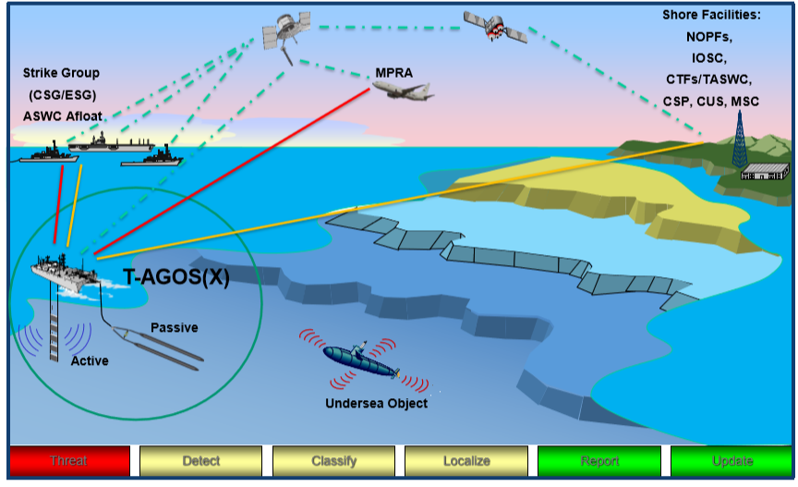
T-AGOS(X) CONCEPT OF OPERATIONS (CONOPS)
‹#›
Notes:
T-AO Fleet Oiler Recapitalization
‹#›

Slide 14
FLEET OVERVIEW
T-AGOS(X) IMPROVEMENTS FROM THE T-AGOS 19 and T-AGOS 23 CLASSES:
Increased ship sprint speed
Improved SWATH hullform and mission handling system allow for improved crew safety and mission operations in higher sea states
Increased crew size and improved accommodations
‹#›

Slide 15
ACQUISITION APPROACH AND SCHEDULE OVERVIEW
‹#›
Notes:
T-AO Fleet Oiler Recapitalization
‹#›

Slide 16
ACQUISITION APPROACH
Two-Phase Acquisition Approach
Phase I – Preliminary/Contract Design (PD/CD) & Industry Studies
Conduct 24 month Navy Led Preliminary/Contract Design effort in FY19-21
Release RFP for Industry Studies in 4th Qtr FY19 focused on special studies, PD/CD feedback and review of draft specifications/Technical Data Package (TDP)
Full and open competition resulting in multiple awards
12-14 month effort
Phase II – Detail Design and Construction
Release RFP for Detail Design and Construction (DD&C) in FY21
Full and open competition with single award for Lead Ship DD&C in FY22
A total of seven ships are currently planned
- Above plan/dates subject to revision
‹#›
Notes:
‹#›

Slide 17
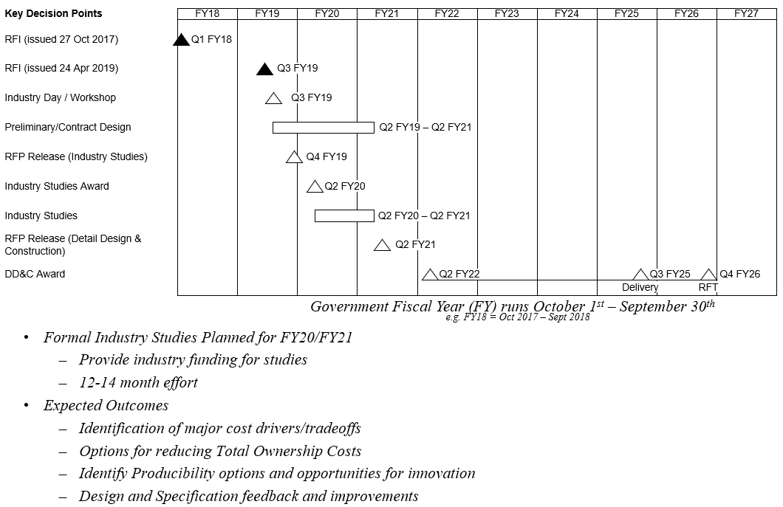
T-AGOS(X) NOTIONAL PROGRAM SCHEDULE
‹#›

Slide 18
OVERVIEW OF INDUSTRY STUDIES SOLICITATION
‹#›
Notes:
T-AO Fleet Oiler Recapitalization
‹#›

Slide 19
INDUSTRY STUDIES SOLICITATION OVERVIEW
Option for Technical Data Package review and feedback on Government PD/CD design products including draft Specification
Current planned special studies:
Propulsion Studies including Integrated Plant design options and a load analysis
Ship Control Study
General Arrangements Study
Total Ownership Cost Reduction Study
Option for Additional Studies
‹#›
Notes:
‹#›

Slide 20
DESIGN OVERVIEW
‹#›
Notes:
T-AO Fleet Oiler Recapitalization
‹#›

Slide 21
CURRENT DESIGN ASSUMPTIONS
Built to commercial rules with Navy features (e.g. SWATH Structural Criteria)
Aviation Capability – High Hover Medical Evacuation Only
No requirement to carry ammunition, except small arms for Anti-Terrorism / Force Protection
Mission seakeeping requirements:
Active/Passive Array Deployment/Retrieval - SS 6 best heading
Active/Passive Array Operations – SS 6 all headings; SS 7 best heading
Compact Low Frequency Active (CLFA) array, TL-29A twin line passive array, & Integrated Common Processor (ICP) SURTASS POR systems with improved mission handling system
‹#›
Notes:
‹#›
T-AO Fleet Oiler Recapitalization

Slide 22
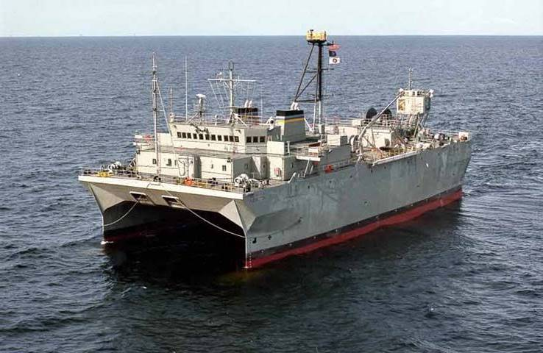
T-AGOS CLASS COMPARISON
T-AGOS (X)
(Notional Parameters)
T-AGOS 23
LENGTH | 281 FT
MAX BEAM | 96 FT
DRAFT | 26 FT
DISPLACEMENT | 5,330 Long Tons (FULL LOAD)
SPEED | 12 Knots
POWER REQUIREMENTS | 3,972 KW
SEAKEEPING | SS6 (All)/SS7 (Best)
ENDURANCE | 75 Days
ACCOMMODATION | 54 Total
C5I | POR
SURTASS | LFA (Active) Twin Line (Passive)
LENGTH | 356 FT
MAX BEAM | 104 FT
DRAFT | 31 FT
DISPLACEMENT | 8,500 Long Tons (FULL LOAD)
SPEED | 20 Knots
POWER REQUIREMENTS | 35-39 MW
SEAKEEPING | SS6 (All)/SS7 (Best)
ENDURANCE | 75 Days
ACCOMMODATION | 68 Total
C5I | POR
SURTASS | CLFA (Active) TL-29A (Passive)
‹#›

Slide 23
DESIGN CONSIDERATIONS
Regulatory Body Changes – Since T-AGOS 23:
Ice Class
MARPOL 12A (Protectively Located Fuel Tanks)
MARPOL Annex V Revised
EPA Tier 4/IMO Tier III Diesel Engine Emissions Requirements
Protective Coating Performance Standard (PSPC)
Intact Stability Code
Ballast Water Management Convention
Hydrocarbon and Fixed Gas Measurement and Detection Systems
Potential ABS Notations:
✠A1, ✠AMS, ✠ACCU , Ice Class D0, DPS-2, UWILD, NIBS, Circle E
‹#›
Notes:
T-AO Fleet Oiler Recapitalization
‹#›

Slide 24
DESIGN SUMMARY
Plan to follow Navy structural practices in conjunction with ABS
Will be “double hulled” and meet the OPA 90, MARPOL, and other rules, regulations or requirements as appropriate
Program will emphasize Affordability and Total Ownership Cost (TOC) Reduction
‹#›
Notes:
T-AO Fleet Oiler Recapitalization
‹#›

Slide 25
QUESTION AND ANSWER SESSION
‹#›
Notes:
‹#›

Slide 26
CLOSING REMARKS
‹#›
Notes:
T-AO Fleet Oiler Recapitalization
‹#›

Slide 27
CLOSING REMARKS
Industry participation is imperative in ensuring T-AGOS(X) is affordable, innovative, producible, and meets the fleet needs of the modern US Navy.
Release the T-AGOS(X) Industry Studies RFP via FedBizOpps planned by late Fiscal Year 2019.
Participants that have registered for a Breakout Session, please check back in 10 minutes prior to your scheduled time.
Thank you for your interest and attendance!
‹#›
Notes:
‹#›

Slide 28
BREAKOUT SESSION GROUND RULES
The break-out session and discussions are not binding and does not constitute a commitment on behalf of the Government.
No detailed information beyond the brief or the RFI will be provided (i.e. future schedule or budget at this time)
If your presentation contains proprietary information and/or business sensitive information please identify the information to the Government during your presentation.
All questions asked during Industry Day are subject to posting on FedBizzOpps at the Governments discretion
No guarantee that the Government will address all questions and/or concerns
In responding, the Government may edit questions for brevity or clarity.
LOGISTICS SLIDE
‹#›

Slide 29
BREAKOUT SESSION GROUND RULES
Industry feedback will be considered in the preparation of the formal RFP.
Industry is reminded that the RFP, when released is what matters. If any conflict or inconsistency exists between today’s discussion and the formal RFP, the RFP governs.
ALL sessions have a 25-minute time limit. This is a hard stop.
LOGISTICS SLIDE
‹#›

